Slide 1

Home
HR
Employes Details
Analysis
Dashboard

Slide 2
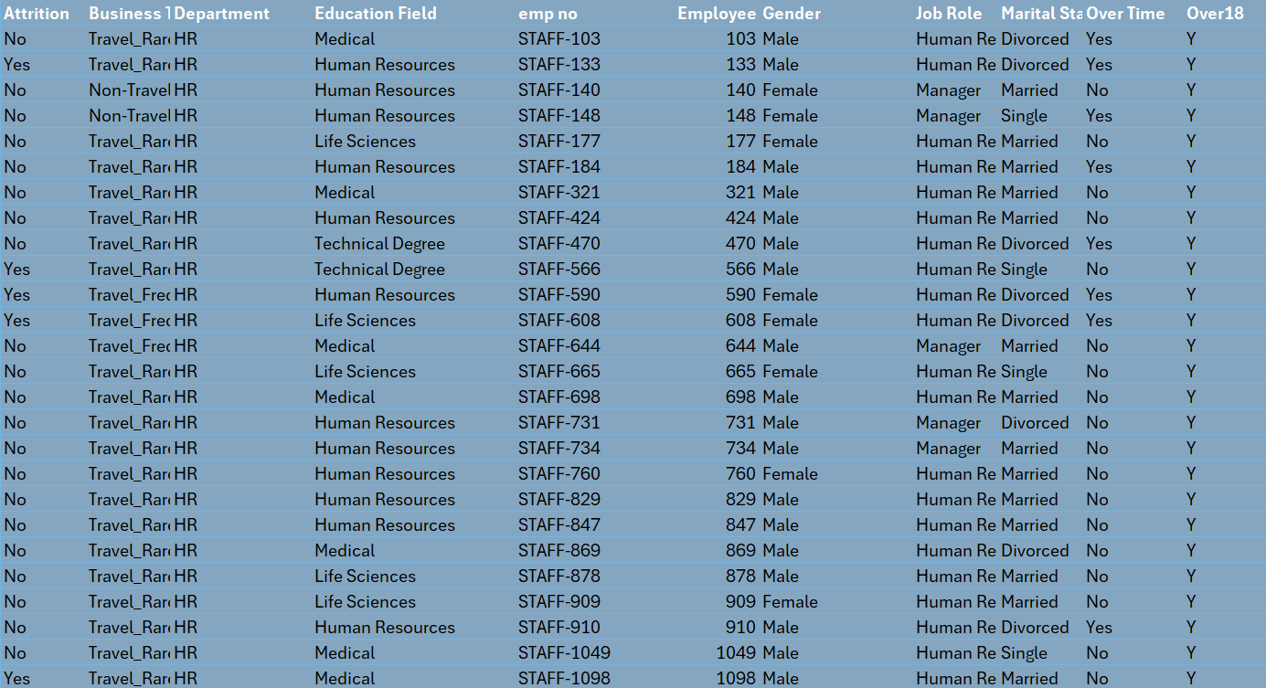
Home
Employes Details
Analysis
Dashboard

Slide 3
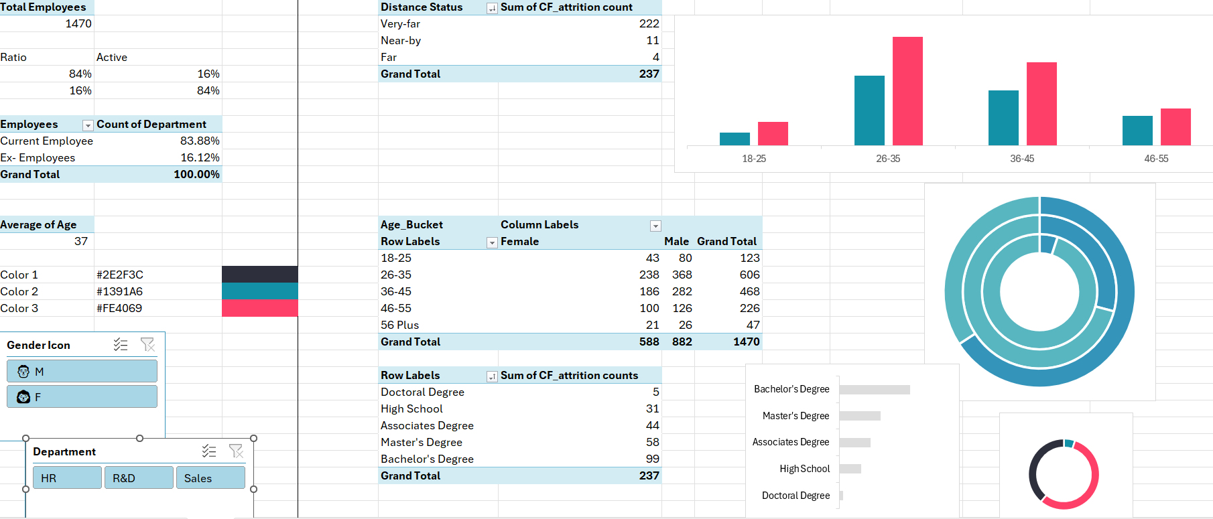
Home
Employes Details
Analysis
Dashboard

Slide 4
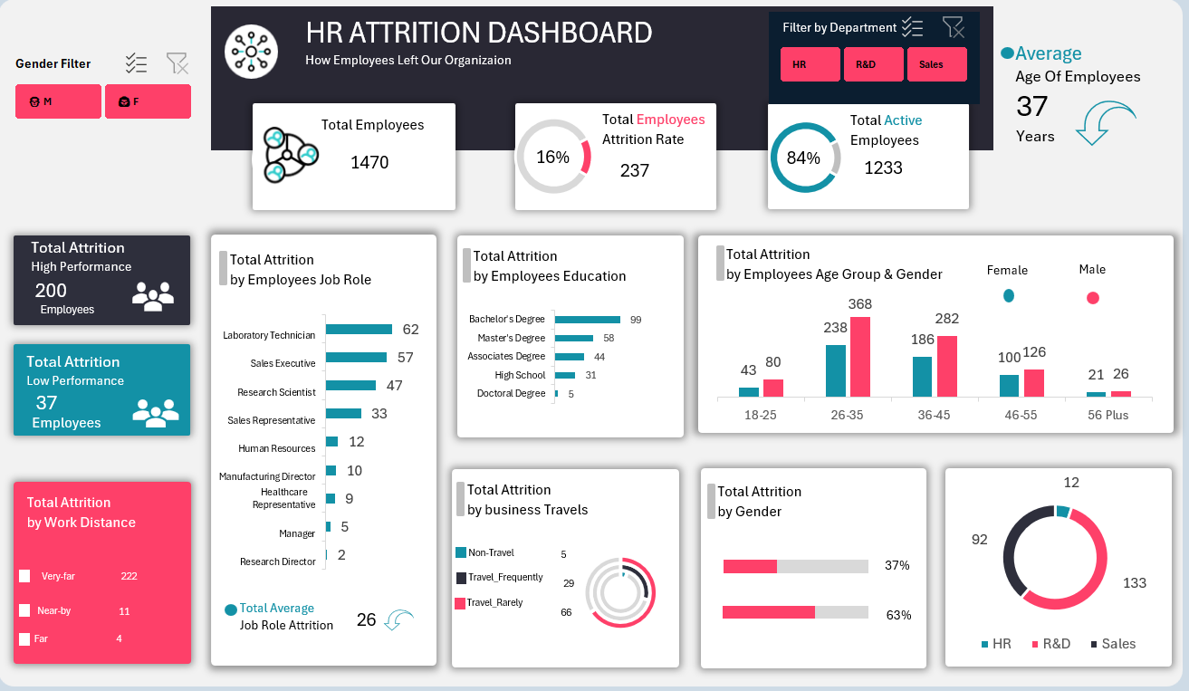
Home
Employes Details
Analysis
Dashboard

